Slide 1
Heaps

Slide 2
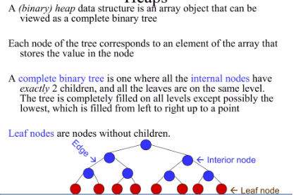
Heaps

Slide 3
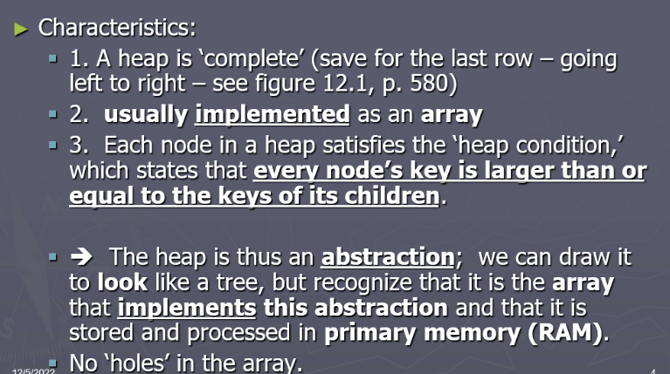

Slide 4
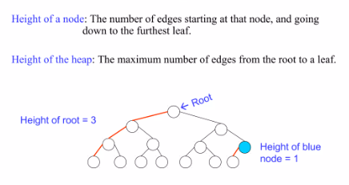
Heaps

Slide 5
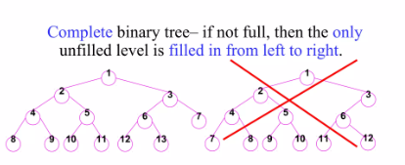
Heaps

Slide 6
Heap Tree Properties
Must follow two properties
Structural properties
Ordering properties
Structural Property
Tree must be ACBT (Almost complete binary tree)
We can move to next level when previous level is complete
Always fill the left child then right child

Slide 7
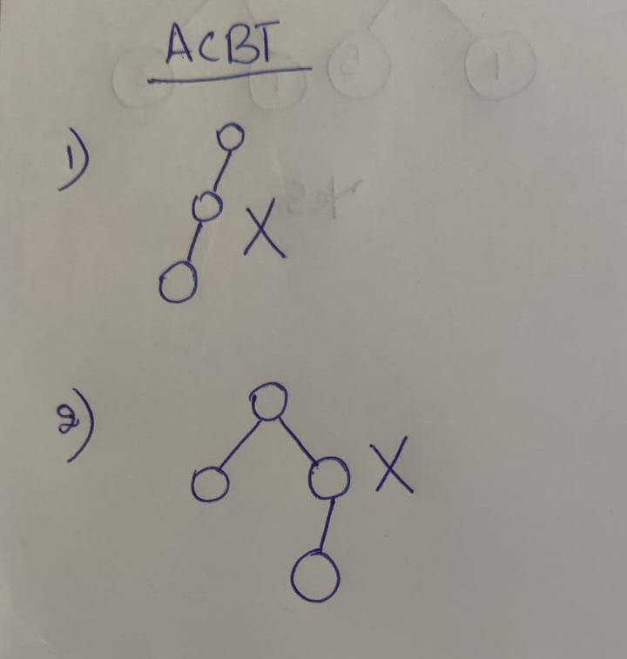

Slide 8
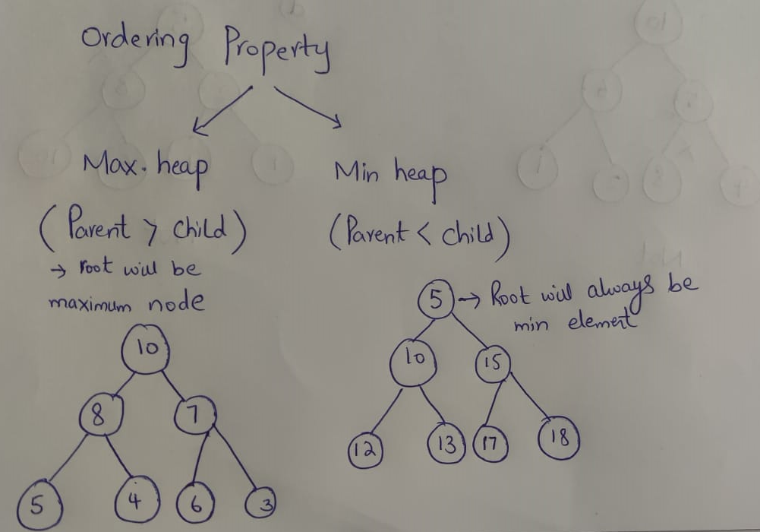
Heaps Properties
Ordering Property
Max heap
Min heap

Slide 9
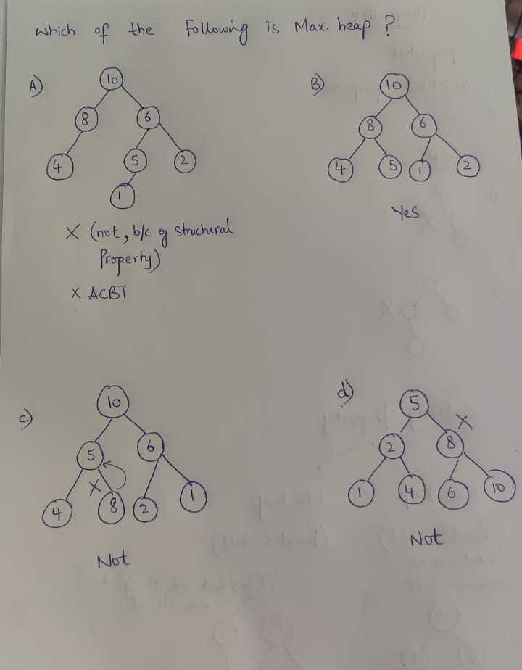

Slide 10
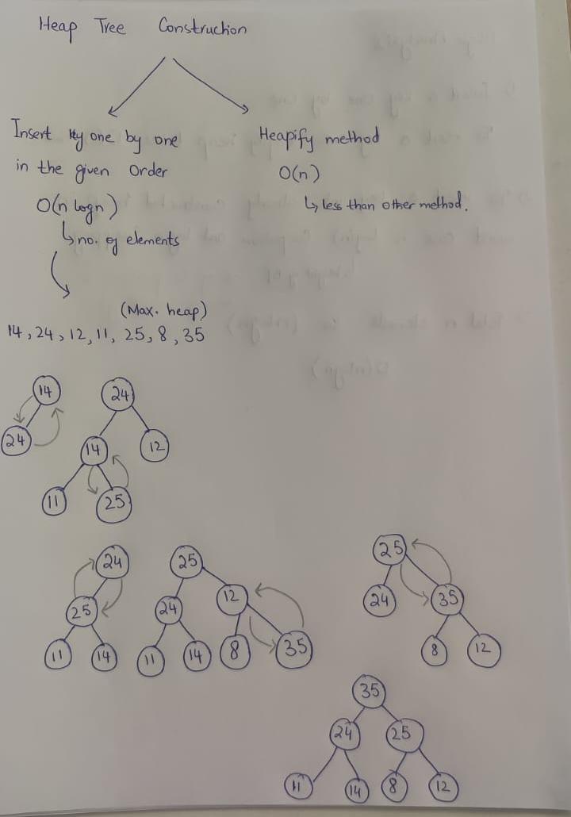
Insertion in Heap Tree

Slide 11
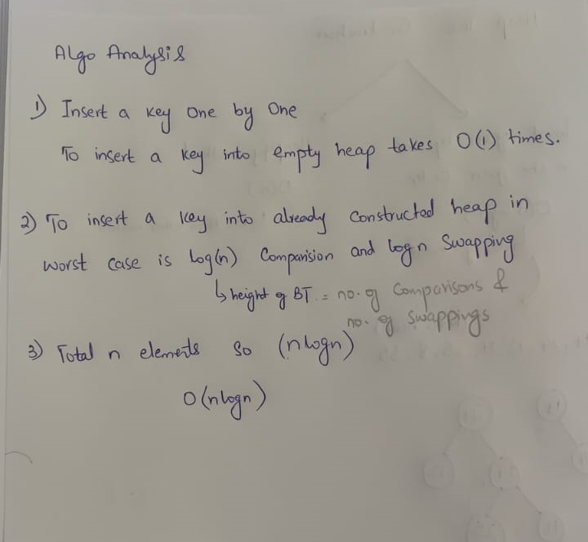
Analysis of Heaps

Slide 12
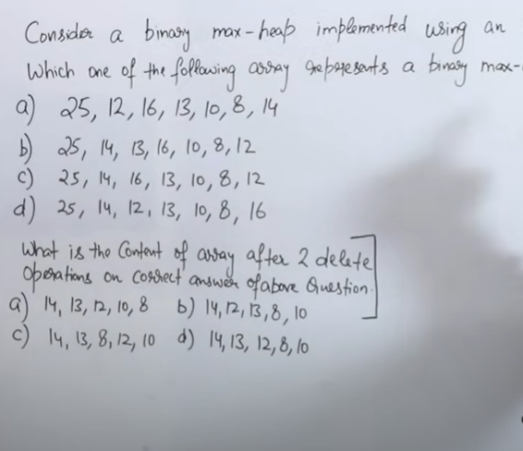

Slide 13
Adding a Node to a Heap
45
Put the new node in the next available spot.
Push the new node upward, swapping with its parent until the new node reaches an acceptable location.
35
23
27
21
22
4
19
42
Notes:
We can add new elements to a heap whenever we like. Because the heap is a complete binary search tree, we must add the new element at the next available location, filling in the levels from left-to-right.
In this example, I have just added the new element with a key of 42.
Of course, we now have a problem: The heap property is no longer valid. The 42 is bigger than its parent 27.
To fix the problem, we will push the new node upwards until it reaches an acceptable location.

Slide 14
Adding a Node to a Heap
45
Put the new node in the next available spot.
Push the new node upward, swapping with its parent until the new node reaches an acceptable location.
35
23
42
21
22
4
19
27
Notes:
Here we have pushed the 42 upward one level, swapping it with its smaller parent 27.
We can't stop here though, because the parent 35 is still smaller than the new node 42.

Slide 15
Adding a Node to a Heap
45
Put the new node in the next available spot.
Push the new node upward, swapping with its parent until the new node reaches an acceptable location.
42
23
35
21
22
4
19
27
Notes:
Can we stop now? Yes, because the 42 is less than or equal to its parent.

Slide 16
Adding a Node to a Heap
45
The parent has a key that is >= new node, or
The node reaches the root.
The process of pushing the new node upward is called reheapification upward.
42
23
35
21
22
4
19
27
Notes:
In general, there are two conditions that can stop the pushing upward:
1. We reach a spot where the parent is >= the new node, or
2. We reach the root.
This process is called reheapification upward (I didn't just make up that name, really).

Slide 17
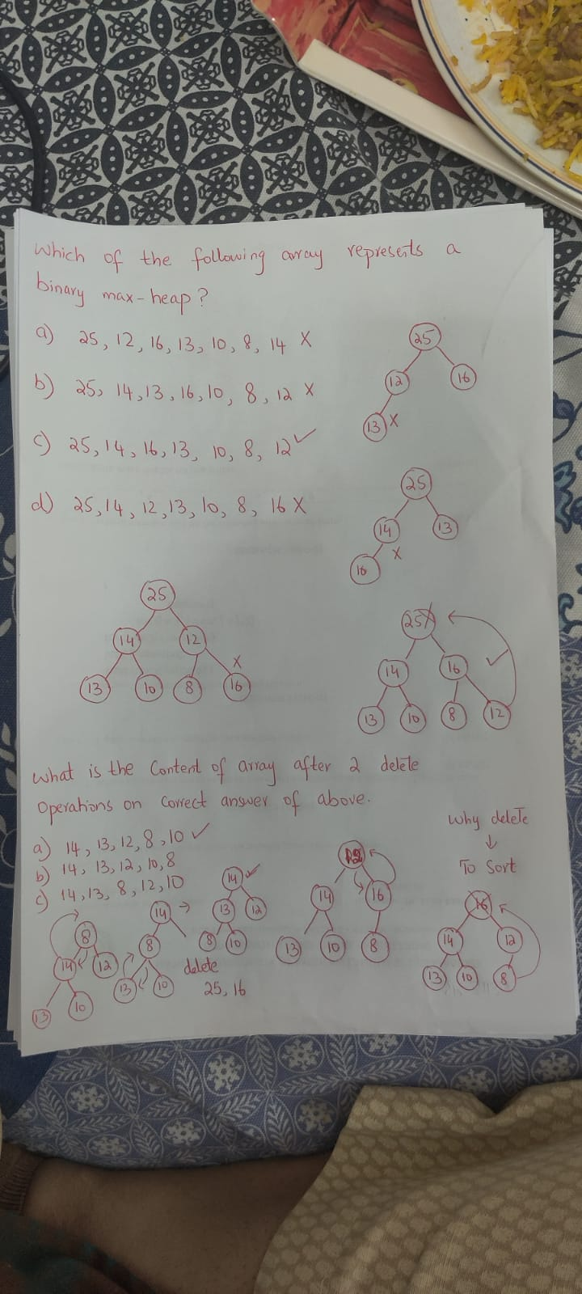

Slide 18
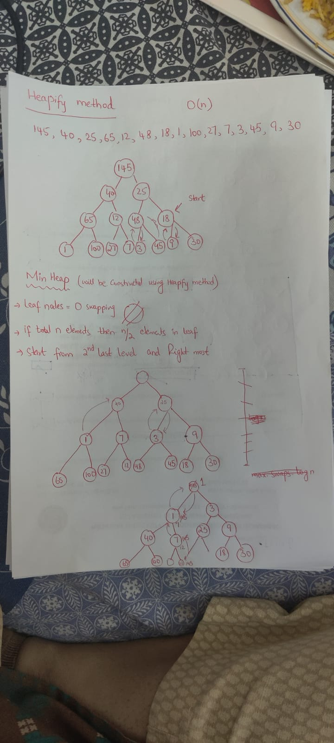
Heapify Method

